Slide 1
Rotting Research: How Link Rot Impacts the Integrity of Scholarly Publishing
Dr. Marshal A. Miller

Slide 2
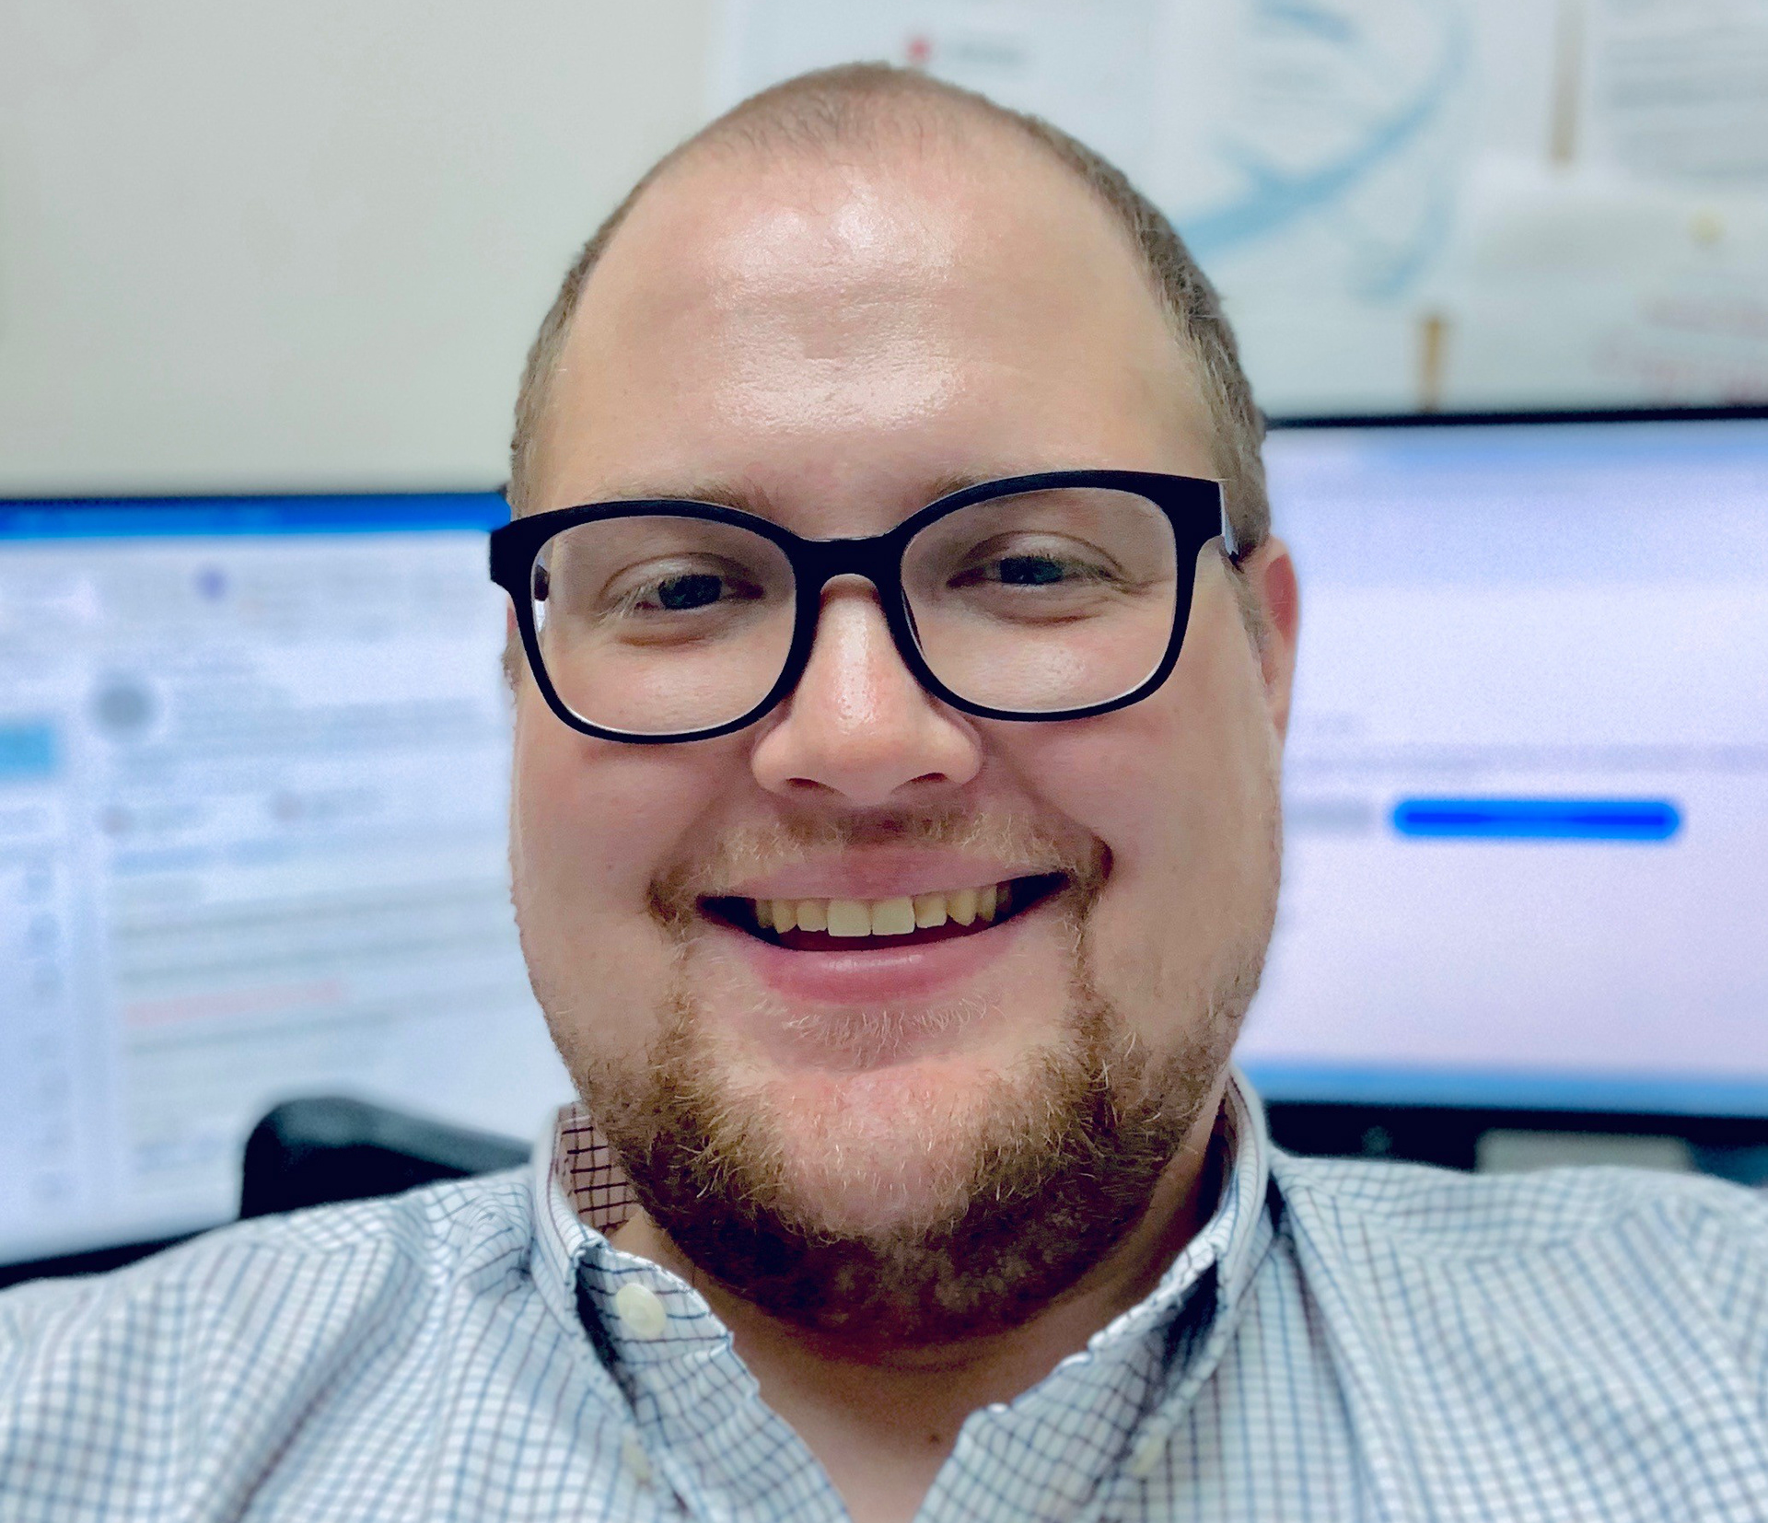
About Me
Dr. Marshal A. Miller
Assistant Professor
Computer & Information Science
Northampton Community College

Slide 3
Learning Objectives
By the end of this presentation, you will be able to:
Define link rot.
Describe the effect of link rot on scholarly research.
Discuss potential remediations.

Slide 4
What is Link Rot?
Link rot: The phenomenon of resources becoming inaccessible over time when their originally cited location is relocated or becomes permanently unavailable. ⁴

Slide 5

How Bad is It?
70% of internet addresses cited in articles published in the Harvard Law Review. ⁴
~50% of links in Supreme Court decisions. ⁴
Link Rot in Law

Slide 6
How Does This Affect Research?
Academics rely heavily on previous research. ⁹
References provide a method for others to retrace the steps a researcher took to establish their position. ⁶
Replication of studies is difficult, or impossible, without the ability to find reference resources. ⁹
Loss of verification calls into question the validity of literature reviews. ⁷

Slide 7
But We Have DOIs
37% of DOI links were broken. ³
33% of DOI links to be broken on one institution’s internal network. ³
51.7% of DOIs were unreachable from outside of the institution’s network. ³

Slide 8
How Does This Affect Research?
Citations tend to decay over time because of a preference for recentness, even over seminal works. ¹
Only 30% of links in the sciences functioned after 4 years. ⁴
The average lifespan for a resource’s website was 9.3 years. ⁴
Unfortunately, only 62% of that data was archived. ⁴
Notes:
Abt (2018) claimed no one
but Zwicky cited the study for 27 years and added that it was not seriously discussed for a total
of 41 years after its publication.

Slide 9
How Does This Affect Research?
Retracted Publications:
The number of retractions issued for research articles in 2023 passed 10,000 in early December. ⁸
Retractions to articles ratio rises 0.2% every year. ⁸
Wiley’s articles were cited more than 35,000 times. ⁸

Slide 10
Rotting Research: The Study
2,500 peer-reviewed scholarly articles.
Published between 2013 and 2022. 250 publications per year.
500 publications from each of the 5 disciplines:
Arts & Humanities
Business
Health and Medicine
Science, Math, and Technology
Social Sciences
Notes:
Research has previously focused on individual disciplines. (Aksnes et al., 2019).
Web of Science, Harvard Law Review, Supreme Court decisions.

Slide 11
Rotting Research: The Study
The overall percentage of broken links was 36%. ⁵
The overall percentage of broken DOIs was 37%. ⁵
Results aligned with previous studies. ⁵

Slide 12
Rotting Research: The Study
Mean of broken links by academic domain. ⁵
Arts & Humanities – 39%
Business – 39%
Health & Medicine – 32%
Science, Math, & Technology – 34%
Social Sciences – 37%

Slide 13
Rotting Research: The Study
Mean of broken DOIs by academic domain. ⁵
Arts & Humanities – 42%
Business – 44%
Health & Medicine – 33%
Science, Math, & Technology – 23%
Social Sciences – 40%

Slide 14
Other Findings
Publishers have internal policies to address DOIs.
Publishers hide their DOIs behind a paywall.
Publishers use 3rd-party services for their DOIs.
Notes:
The best link to use is the one most likely to provide continual access to the resource. ²
Without providing any means of checking the link besides logging in.
Most style guides advise pointing to a public abstract.
Crossref serves as one example that frequently appeared in 300-level response codes.
Using a third-party service adds another possible point of weakness in the process.

Slide 15
Other Findings
Style guides may play a part in this issue.
Study guides are updated at different intervals.
Some contain outdated information.
Notes:
One possible factor contributing to these percentage differences involves the use of different style guides.
Some study guides have changed more frequently than others, and some still contain outdated information in their most recent versions.

Slide 16
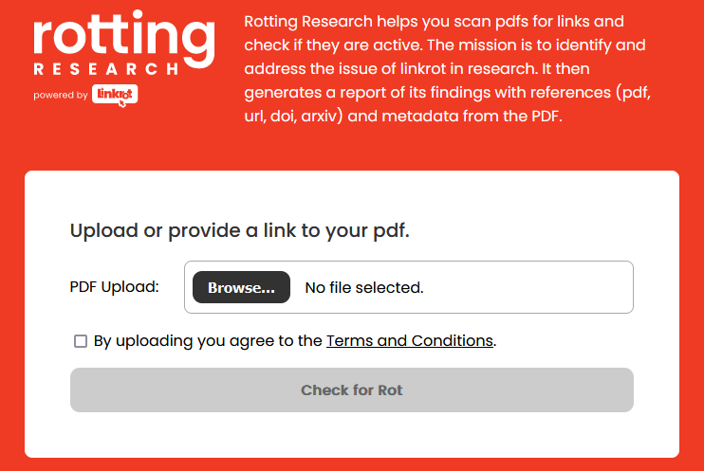
Rotting Research: The Project
Upload PDF
Checks for Links
Checks for DOIs
Downloadable Report

Slide 17
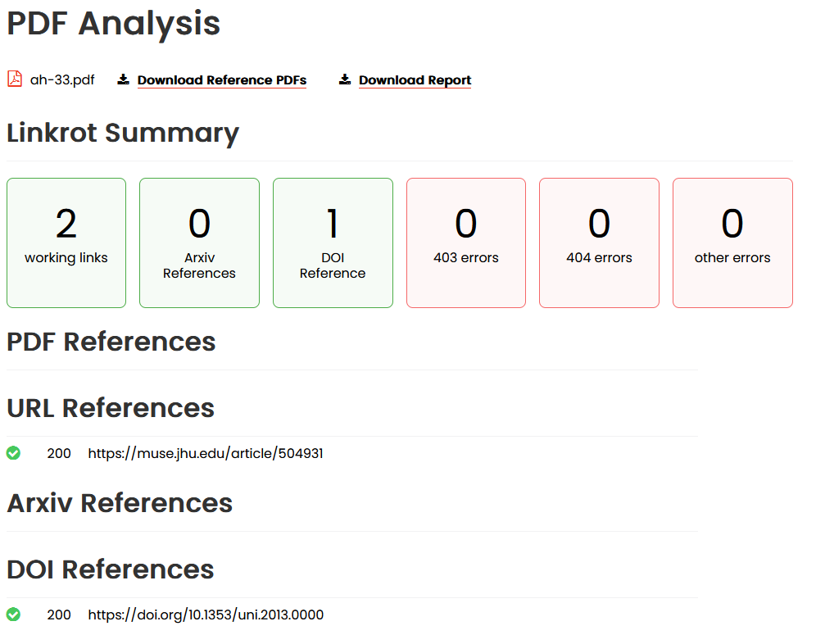
Rotting Research: The Plan
Archive via Internet Archive
Detect Retractions
Database for Future Studies
Change Detection

Slide 18
Rotting Research: The Conversation
Content Drift
Citation Managers
Style Guides
3rd-Party Services
DOIs
Pre-Publishing
Role of Librarians
Iterative Citations
Library of Congress
Copyright
Future Research
Solutions

Slide 19
Resources
Gerow, A., Hu, Y., Boyd-Graber, J., Blei, D. M., & Evans, J. A. (2018). Measuring discursive influence across scholarship. Proceedings of the National Academy of Sciences of the United States of America, 115(13), 3308–3313.
Homenda, N. (2021). Persistent URLs and Citations Offered for Digital Objects by Digital Libraries. Information Technology and Libraries (Online), 40(2), 1–12. http://dx.doi.org/10.6017/ital.v40i2.12987
Klein, M., & Balakireva, L. (2021). An extended analysis of the persistence of persistent identifiers of the scholarly web. International Journal on Digital Libraries. https://doi.org/10.1007/s00799-021-00315-w
Król, K., & Zdonek, D. (2020). Peculiarity of the bit rot and link rot phenomena. Global Knowledge, Memory and Communication, 69(1/2), 20–37. http://dx.doi.org/10.1108/GKMC-06-2019-0067
Miller, M. A. (2022). The Putrefaction of Digital Scholarship: How Link Rot Impacts the Integrity of Scholarly Publishing [Ed.D., Southeastern University]. In ProQuest Dissertations and Theses (2841257231). ProQuest Central. https://www.proquest.com/dissertations-theses/putrefaction-digital-scholarship-how-link-rot/docview/2841257231/

Slide 20
Resources
Penders, B. (2018). Ten simple rules for responsible referencing. PLoS Computational Biology, 14(4), 1–6. https://doi.org/10.1371/journal.pcbi.1006036
Rubbo, P., Pilatti, L. A., & Picinin, C. T. (2019). Citation of Retracted Articles in Engineering: A Study of the Web of Science Database. Ethics & Behavior, 29(8), 661–679. https://doi.org/10.1080/10508422.2018.1559064
Van Noorden, R. (2023). More than 10,000 research papers were retracted in 2023—A new record. Nature. https://doi.org/10.1038/d41586-023-03974-8
West, R., Stenius, K., & Kettunen, T. (2017). Use and Abuse of Citations. In K. Stenius, T. F. Babor, R. Pates, M. Miovský, J. O’Reilly, & P. Candon (Eds.), Publishing Addiction Science (pp. 191–206). Ubiquity Press; JSTOR. https://www.jstor.org/stable/j.ctv3t5qxw.16

Slide 21
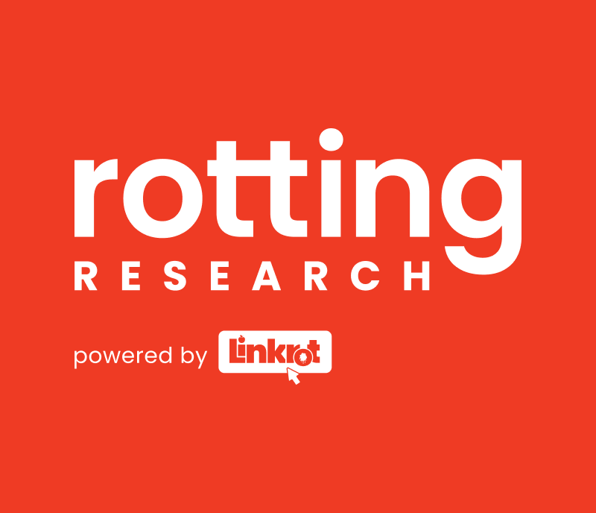
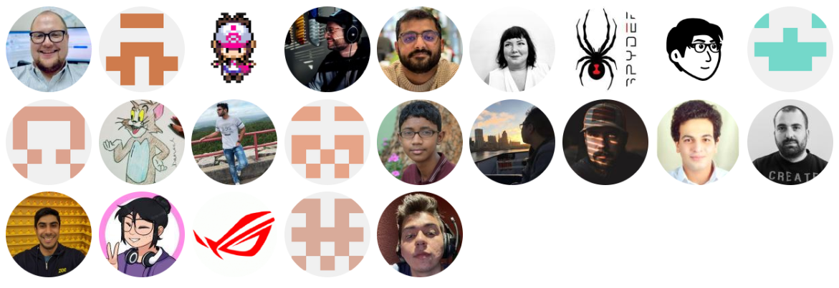
Contributors
https://rottingresearch.org

Slide 22

Leave Feedback
Thank you for attending our session and joining in the discussion.
https://rottingresearch.org
Contact me: mmiller@northampton.edu
https://app.keysurvey.com/f/41693657/5c14/

